Slide 1
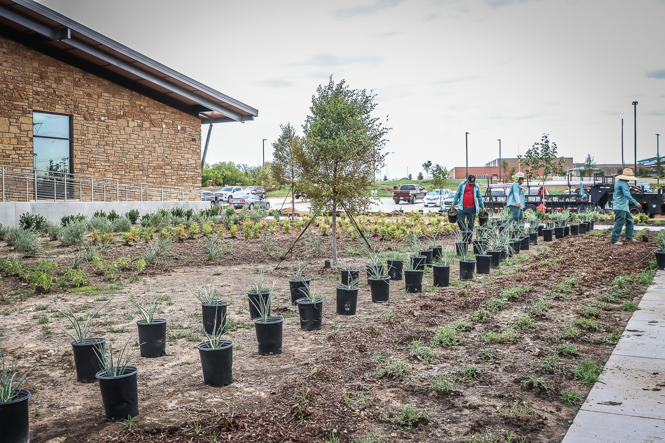
ADMINISTRATION BUILDING
Landscaping continues to progress.

Slide 2
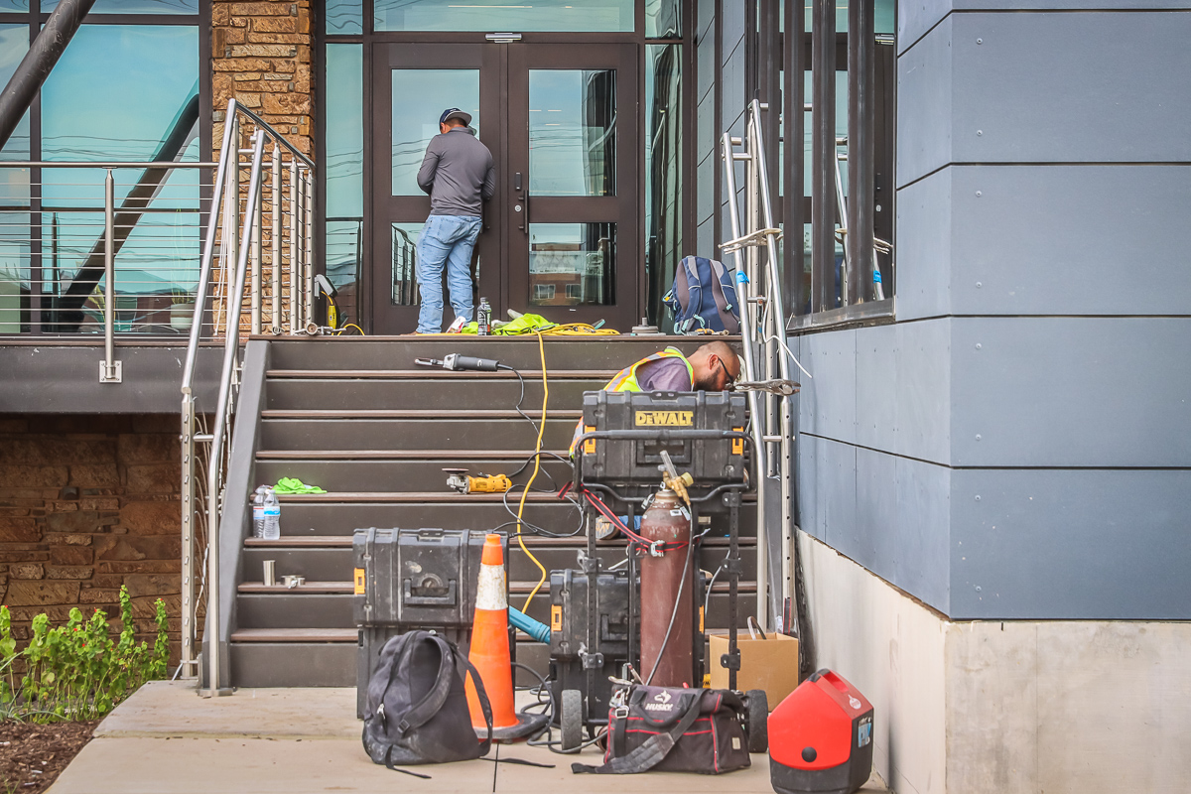
Finish items and punch items are progressing in Area C.

Slide 3
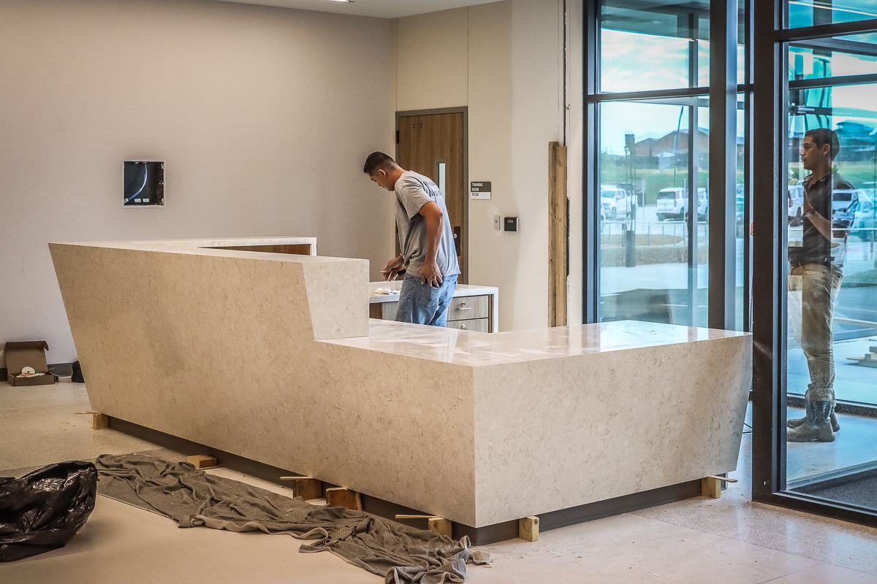
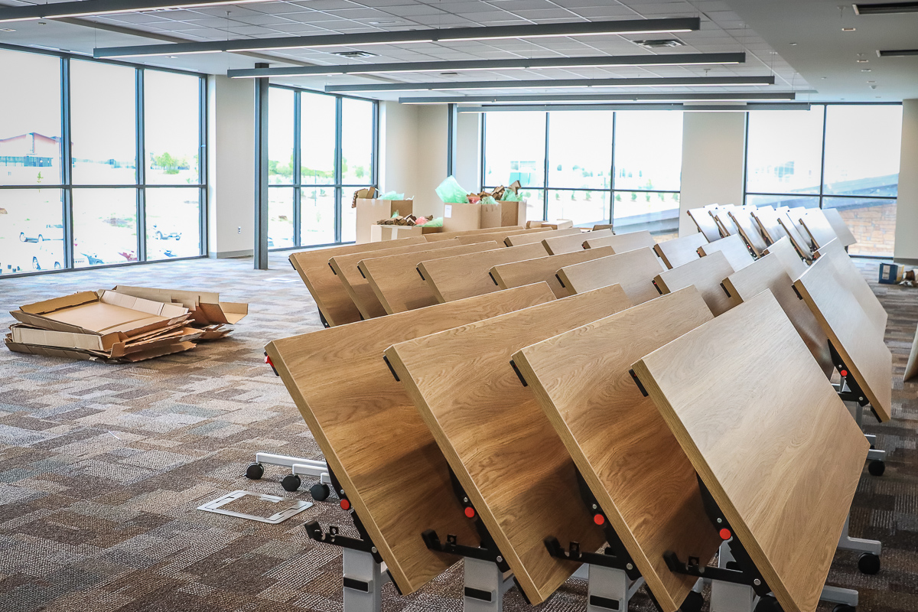
Finishing touches on the reception desk continues along with furniture delivery and install in Area B training room.

Slide 4
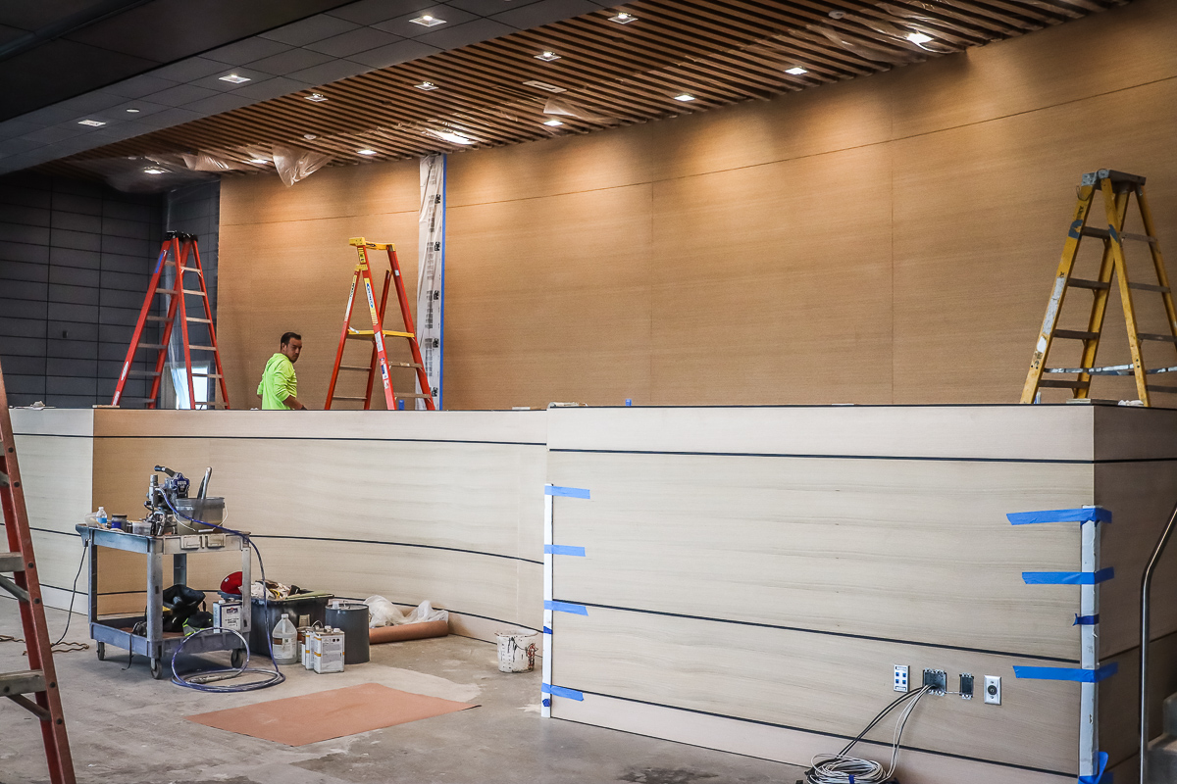
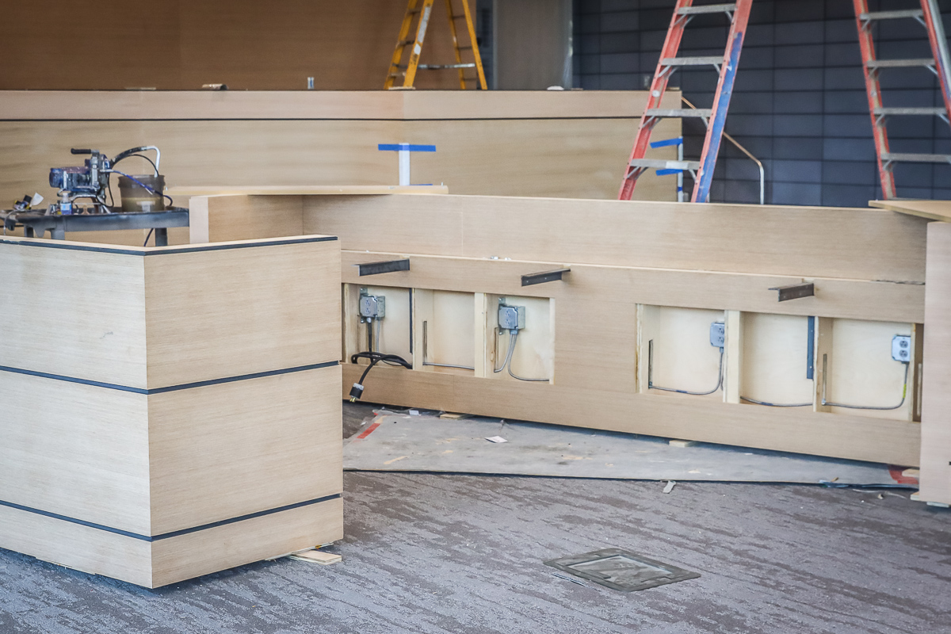
The dais area is undergoing final installation and staining of wood panels.

Slide 5
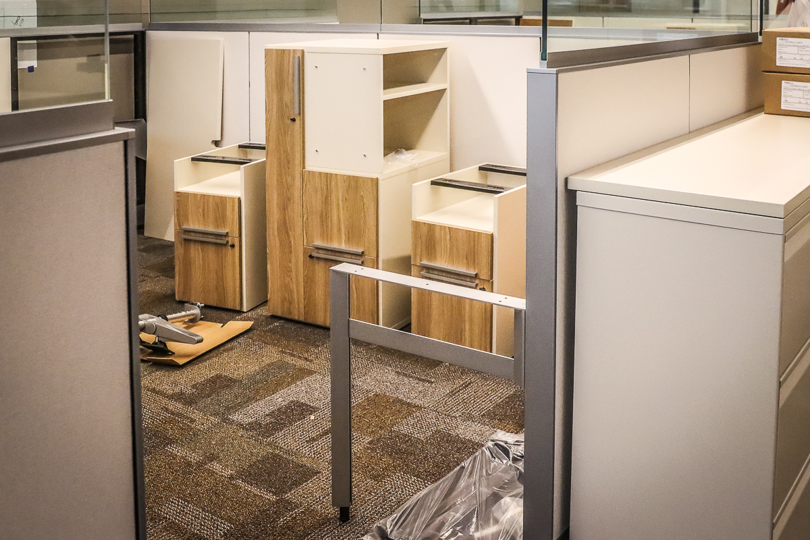
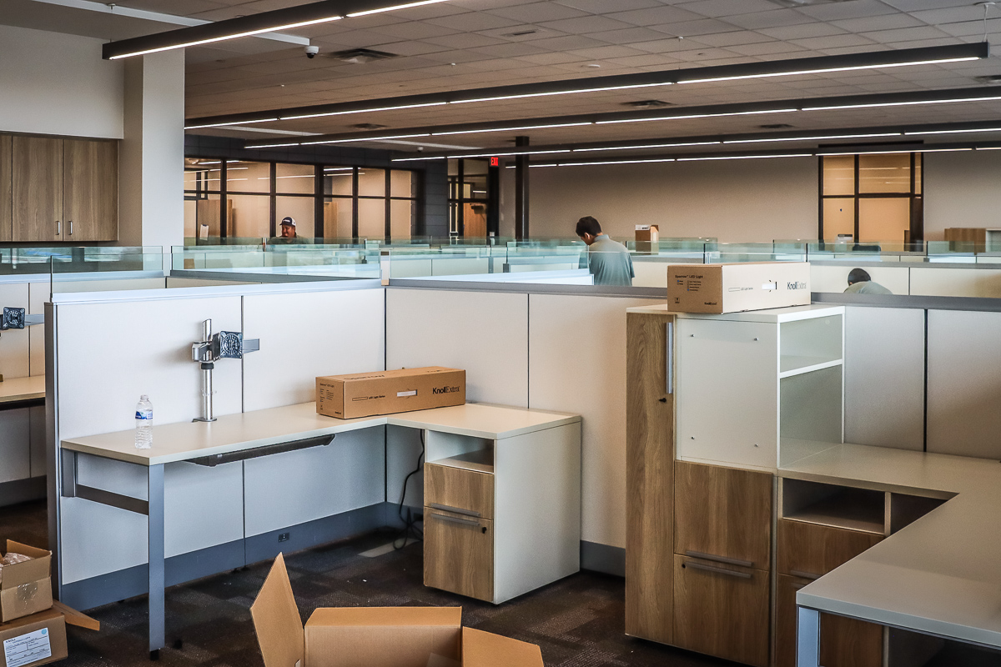
Furniture delivery and install continues in Area B.

Slide 6
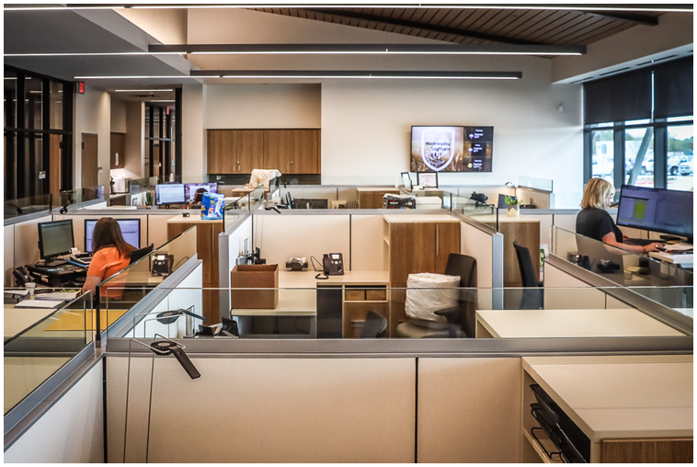
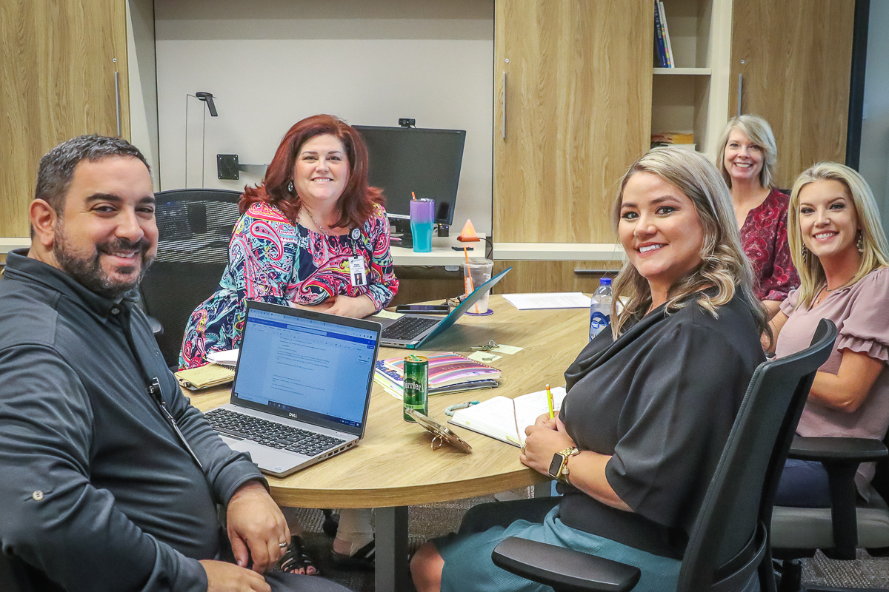
Work continues in the new offices.

Slide 7
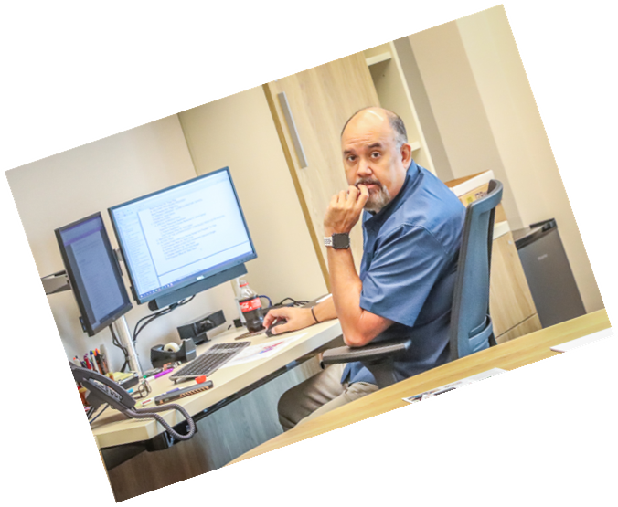
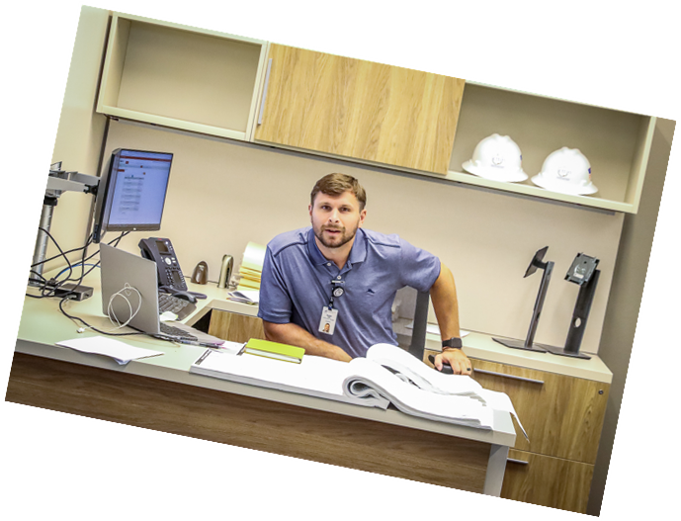
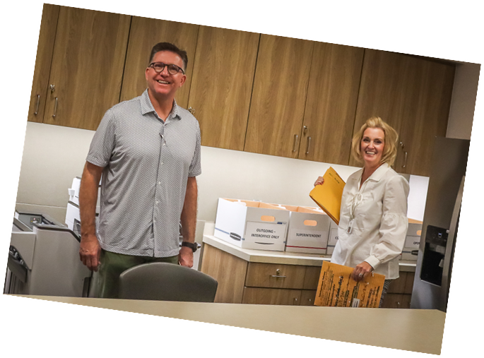

Slide 8
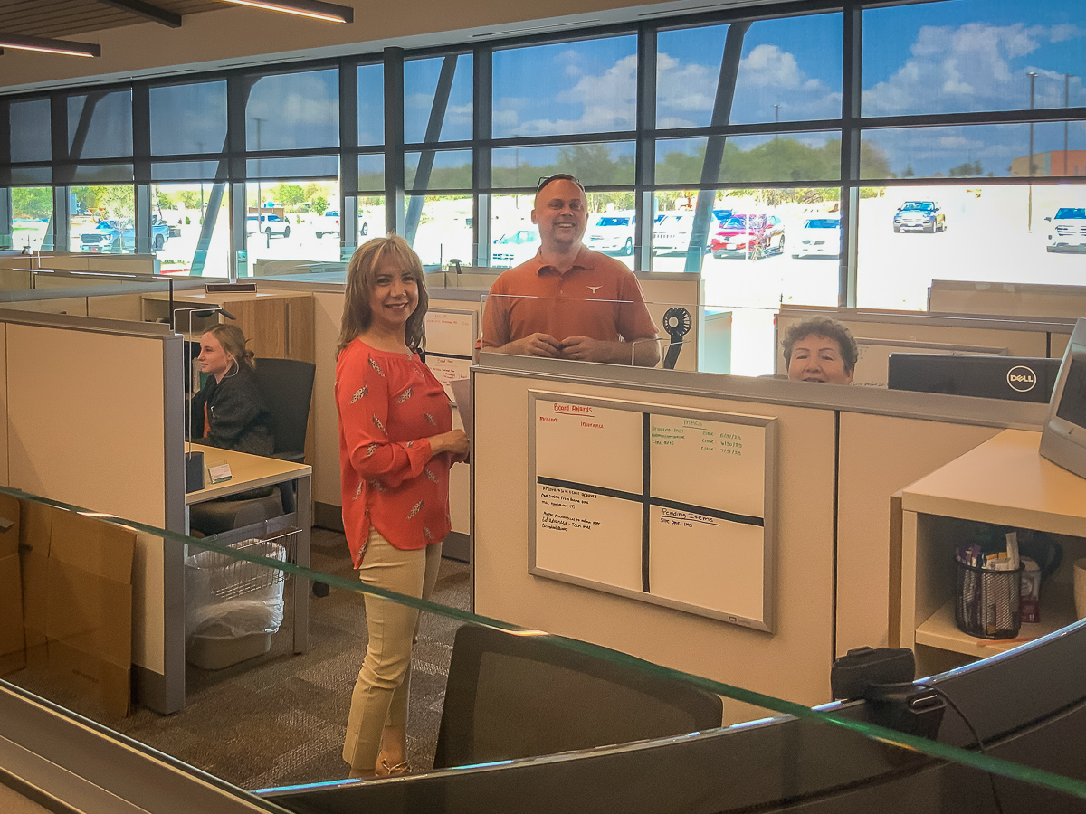
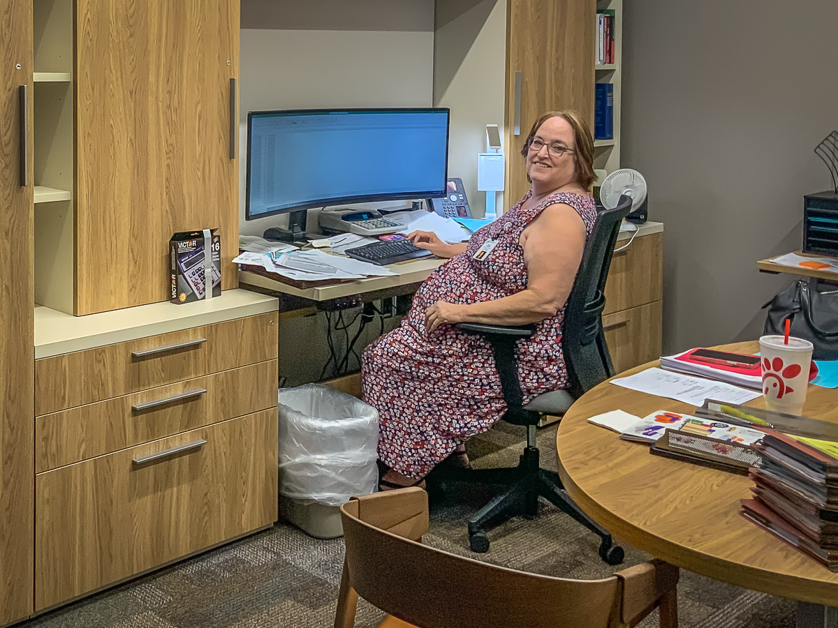
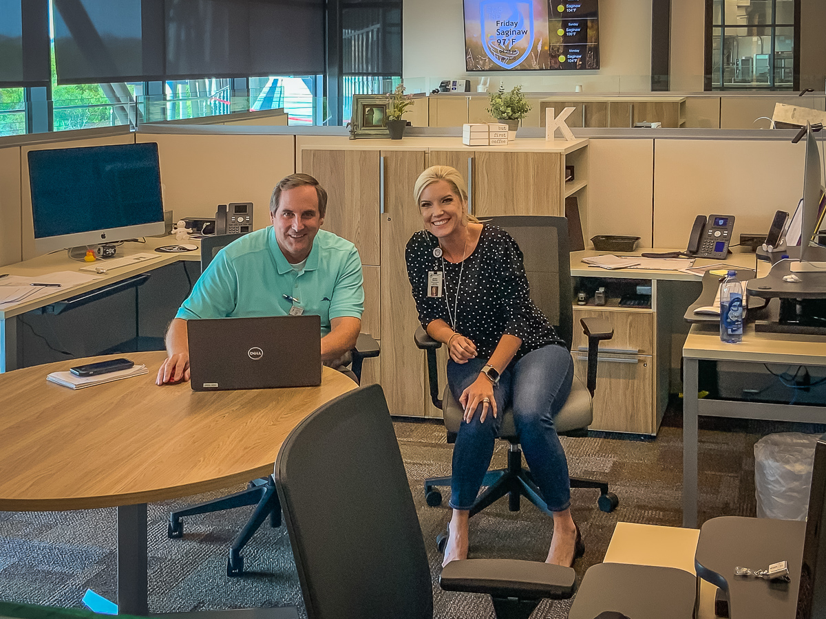

Slide 9
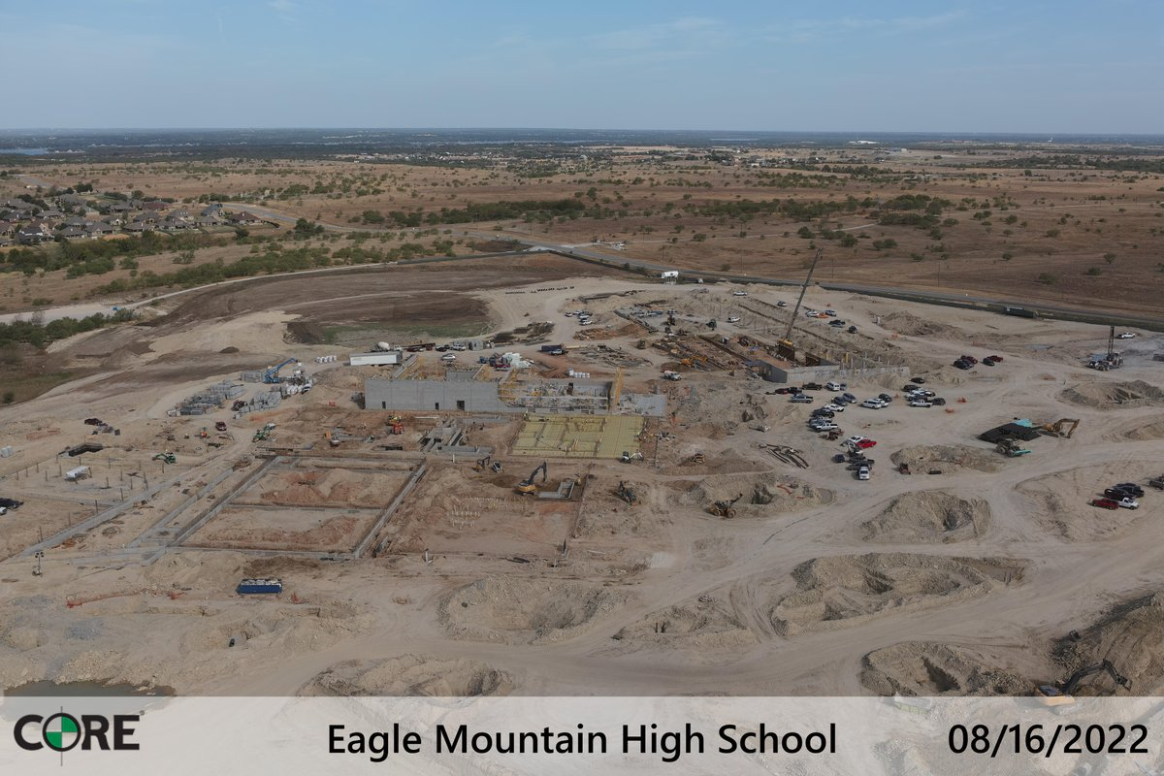
EAGLE MOUNTAIN HS
Work continues on grade beams and slab prep in all areas of the main building. The slab is poured in a portion of fine arts. Laying of CMU blocks has begun.

Slide 10
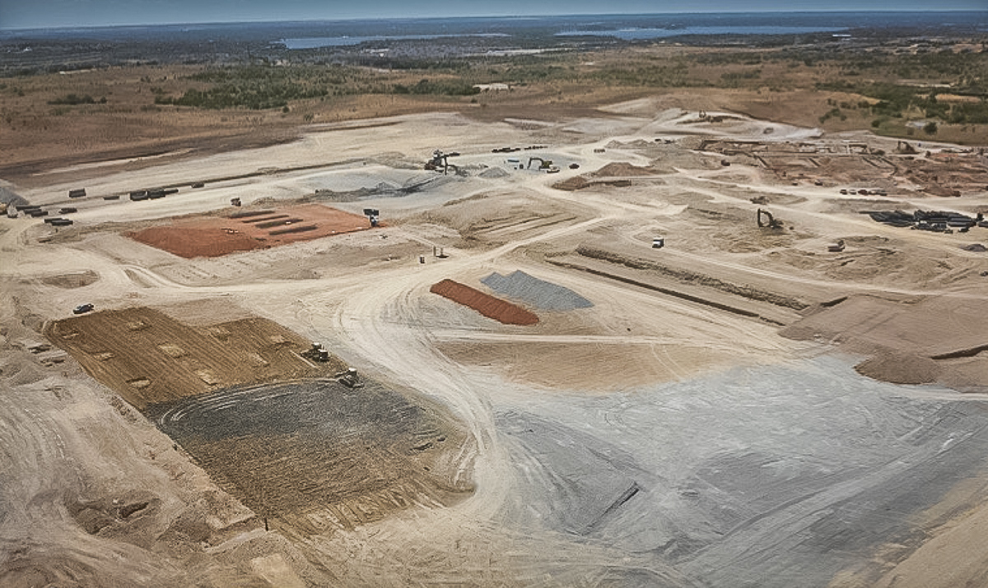
Stadium preparation continues and the field house building pad is complete along with piers.

Slide 11
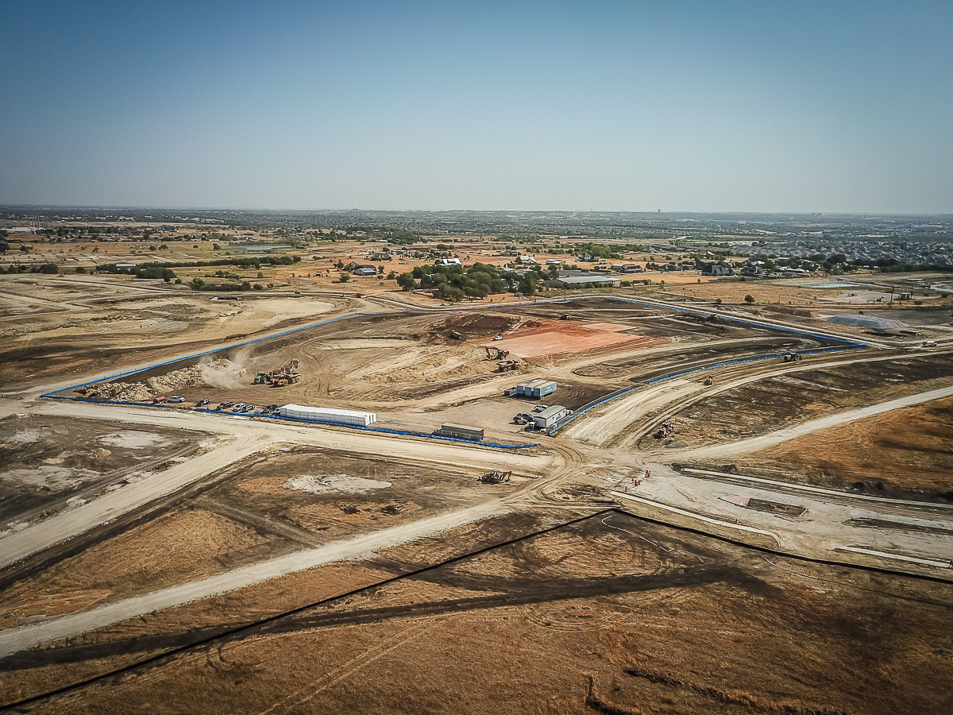
ELEMENTARY 18
Earth work sub continues to construct the building pads and cutting in the on-site roads and parking lots.

